Slide 1

World Life expectancy

Slide 2
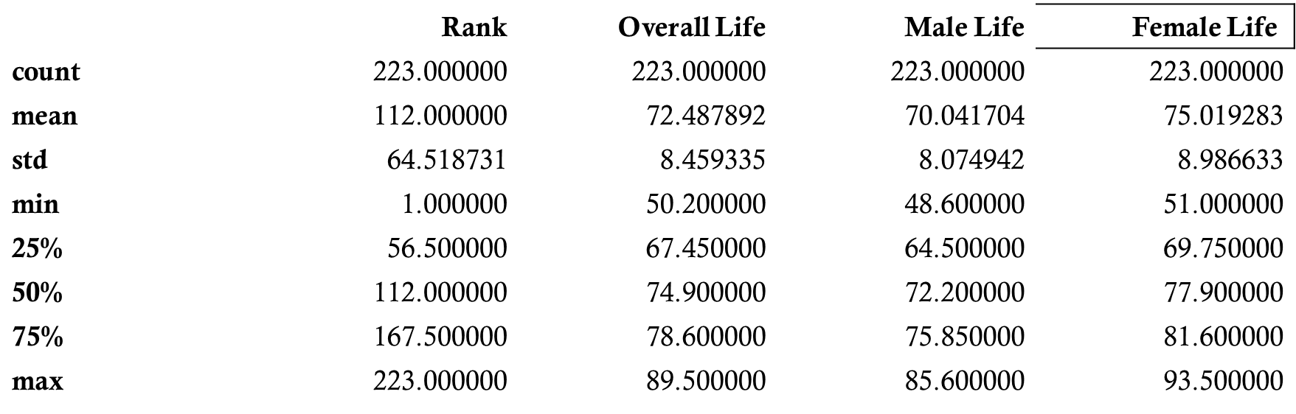
How many years will we live?
This question lingers in billions of minds all day for billions of reasons. Whether its to figure out how much time we have with our loved ones or how much time we have to complete our Beany Babies collection, the very existence that we are actually on borrowed time motivates us to truly push to our purpose and make purposeful decisions.
This data explores life expectancy across 223 countries and 6 continents grouped and ranked by males, females and overall life expectancy. Certainly we can learn life prolonging tactics from the countries with the highest ranks of survival, right?
Which is exactly why our target question is “Which continent has the highest ranks of survival?”

Slide 3
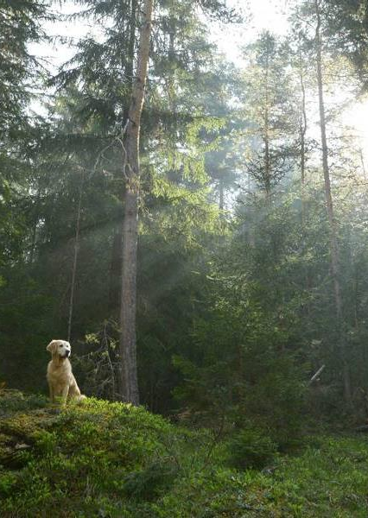
INformation overview
Let’s take a look at the data, make sure its clean enough to properly analyze and insure the features that we have are viable to our target question.

Slide 4
Data Cleaning and Feature Engineering
We made sure there were no missing values, outliers or duplicates inside the data.
Overall the data is quite clean and by also taking a look at the correlation calculation, Overall Life is mostly related with Male Life and Female Life and can conclude as using this as a feature.
Null Analysis Rank
Country | 0
Overall Life | 0
Male Life | 0
Female Life | 0
Continent | 0
Correlation Matrix
Rank Overall Life Male Life Female Life
Rank 1.000000 -0.947263 -0.952202 -0.932723
Overall Life -0.947263 1.000000 0.993517 0.993615
Male Life -0.952202 0.993517 1.000000 0.976694
Female Life -0.932723 0.993615 0.976694 1.000000

Slide 5
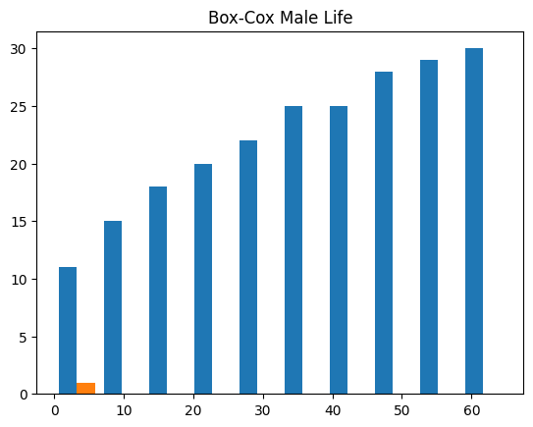
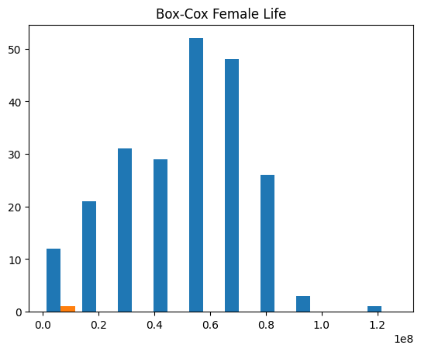
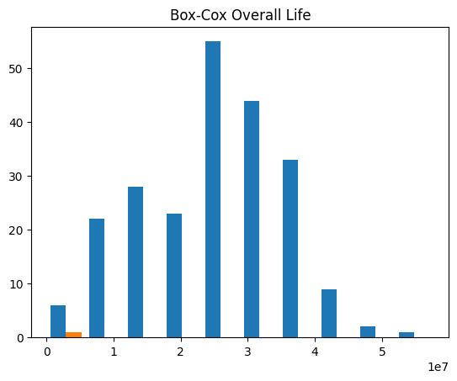

Normally Distributed Enough?
From looking at the plots, Overall Life and Female Life have normal bell curves that show relevancy. We also know that the Continent is part of the important features. However, Female Life is closest to correlation with Overall Life instead of Male Life, so Female Life will be a secondary relevant feature also. Concluding, Overall Life and the Continent will be the features used to get to the target variable.

Slide 6

Which Classifying model works best for the target?
Which continent has the most countries with the highest ranks of survival?

Slide 7
Knn classification
 | Precision | Recall | F1-Score | Support
Africa | 0.74 | 0.95 | 0.83 | 55
Asia | 0.63 | 0.86 | 0.72 | 49
Europe | 0.79 | 0.80 | 0.80 | 51
North America | 0.67 | 0.35 | 0.46 | 34
Oceania | 1.00 | 0.25 | 0.40 | 20
Southern America | 73 | 0.57 | 0.64 | 14
Accuracy |  |  | 0.72 | 223
Macro Avg | 0.76 | 0.63 | 0.64 | 223
Weighted Avg | 0.74 | 0.72 | 0.69 | 223
Since the target question involves a specific category, we are utilizing the KNN classification model with the model justification to the right.
Africa has the highest F-1 score with a 72% accuracy but when asked for the predicted continent, we were given Europe.
This is quite an odd occurrence so we will utilize another classification model to further explore.
Best Ranked Continent: Europe
Accuracy: 0.7174887892376681

Slide 8
Random forest classifier
 | Precision | Recall | F1-Score | Support
Africa | 1 | 1 | 1 | 55
Asia | 1 | 1 | 1 | 49
Europe | 1 | 1 | 1 | 51
North America | 1 | 1 | 1 | 34
Oceania | 1 | 1 | 1 | 20
Southern America | 1 | 1 | 1 | 14
Accuracy |  |  | 1 | 223
Macro Avg | 1 | 1 | 1 | 223
Weighted Avg | 1 | 1 | 1 | 223
Since the target question involves a specific category and we want to use another classification method for accuracy, with the model justification to the right.
From this table, all scores are 1 insuring an 100% accuracy for the best ranked continent of Africa.
This is very odd as we can see from the data that the overall life for Africa is among the lowest, along with male and female life.
Best Ranked Continent: Africa
Accuracy: 1.0

Slide 9
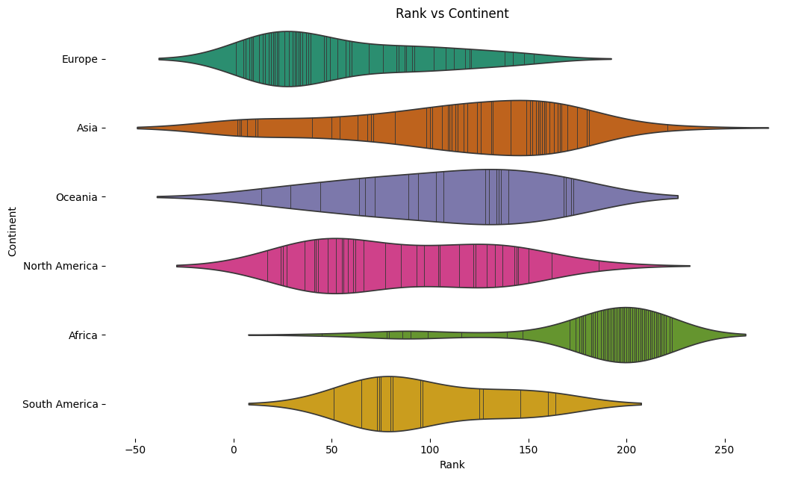
Plotting the truth
Since the models were giving us mixed signals, we decided to plot the findings using a violin plot to show the rank spread of each continent.
The plot does show that Africa does have the highest number of high ranked countries BUT we are actually looking for the continent with the highest amounts of low ranks since the high ranks means low overall life.
Given that information and the plot display, we conclude on Europe having the most amount of low ranked countries.

Slide 10
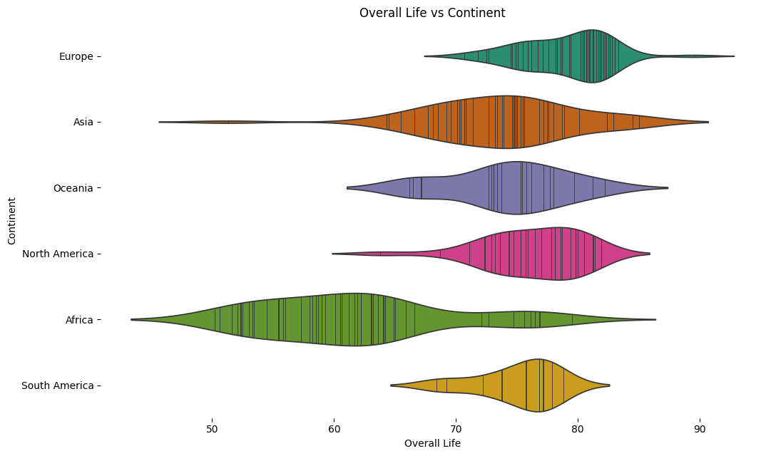
Plotting the truth
Since we know Overall Life is a viable feature for this target question, we plotted it against the country count in each continent.
From the plot, we can also see that Africa clearly has the highest number of low overall life ages as in this case having a high rank is not a good thing!
Also from the plot, we can conclude that Europe has the most countries with the highest overall life ages with North America coming in a close 2nd.

Slide 11
Conclusion & Recommendations
Random Forest - we utilized this method with classifying in order to aggregate the countries with highest overall life ranks, incorporate the proper questions and grab the continent associated with target and support the accuracy.
Even though the model stated "Africa" and came out with an accuracy of 1, why does Africa have the lowest overall life expectancies ages? From looking at the question again, this model returned the programmed information BUT not what the target variable needs to accomplish. Main recommendation going forward would be to be more specific with the target question and use other models to confirm accuracy.
Technically Africa does have the most countries with the "highest ranks" of overall life BUT the "ranks" are misconstrued and the lower the rank the better. Concluding that KNN classifier model predicted the actual information that was needed.
Which continent has the most countries with the highest ranks of survival?
The short answer is Europe but the long and probably most accurate answer lies beneath more accurate models.
The best model and most accurate out of the two was the KNN classifier similarity method. KNN Classifier - model seemed to be utilized properly by identifying the countries with the highest ranks and grouping them together in order to properly identify the continent with the highest count.

Slide 12
What’s next?
How do Europeans stretch their life lengths?
Is their quality of life just as good as their length of life?
What practices of everyday life are being used in Europe that aren’t being used in any other continents to attribute to the life longevity?
We could answer a million questions and have a million answers more.
The data pinpoints a group of beings utilizing a certain lifestyle that helps them live longer than anyone else on the planet.
Overall, we can learn the do’s and don’t of living the longest life possible.

Slide 13
Thank you!
Jonard Bennett
678-883-7165
jbennett239@gmail.com

